Slide 1

Analysis on Mashable using PostgreSQL

Slide 2
Source of Data
Statistics for news articles retrieved from Mashable, an online news website
Source: AI Apprenticeship Programme Technical Assessment
No. of records: 39k+

Slide 3
Purpose of the analysis
to track which data channel has the highest articles’ shares
to find the possible factors that influence the number of shares of the article

Slide 4
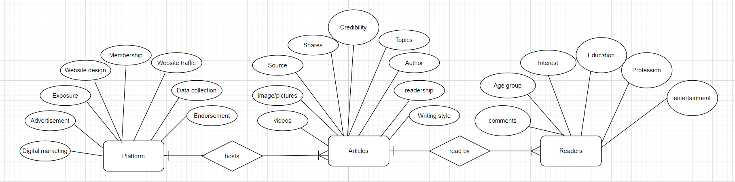
Entity Relationship Diagram

Slide 5
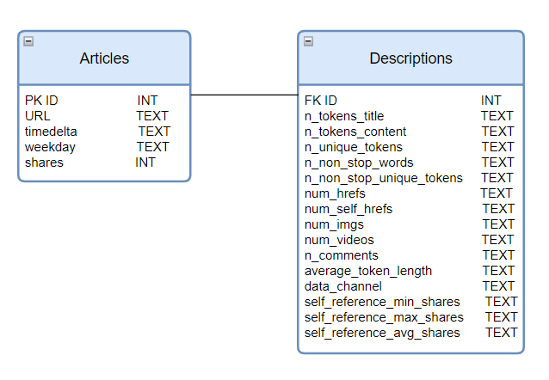
Schema and Table Diagram

Slide 6
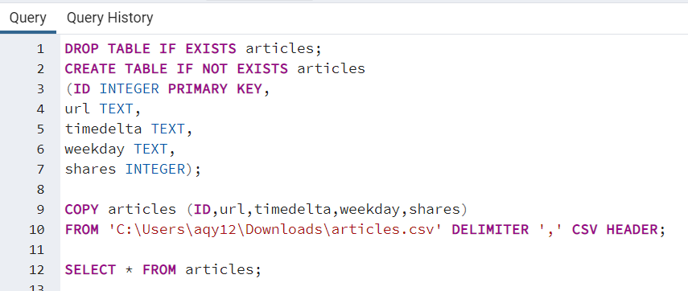
Data Analysis using PostgreSQL
1. Creating table and Importing ‘Articles’ data using COPY FROM method

Slide 7
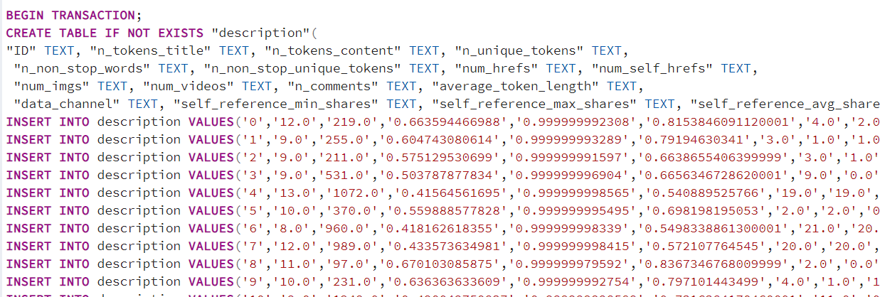
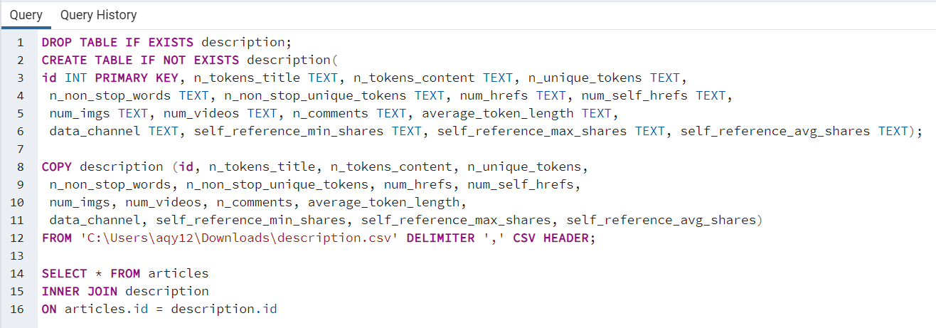
2. Creating table and Importing ‘Description’ data using sqlite 3 method
During SQL parts, sqlite could not dump the full 39k rows of csv file
A table has to manually create and use COPY FROM method to import the data

Slide 8
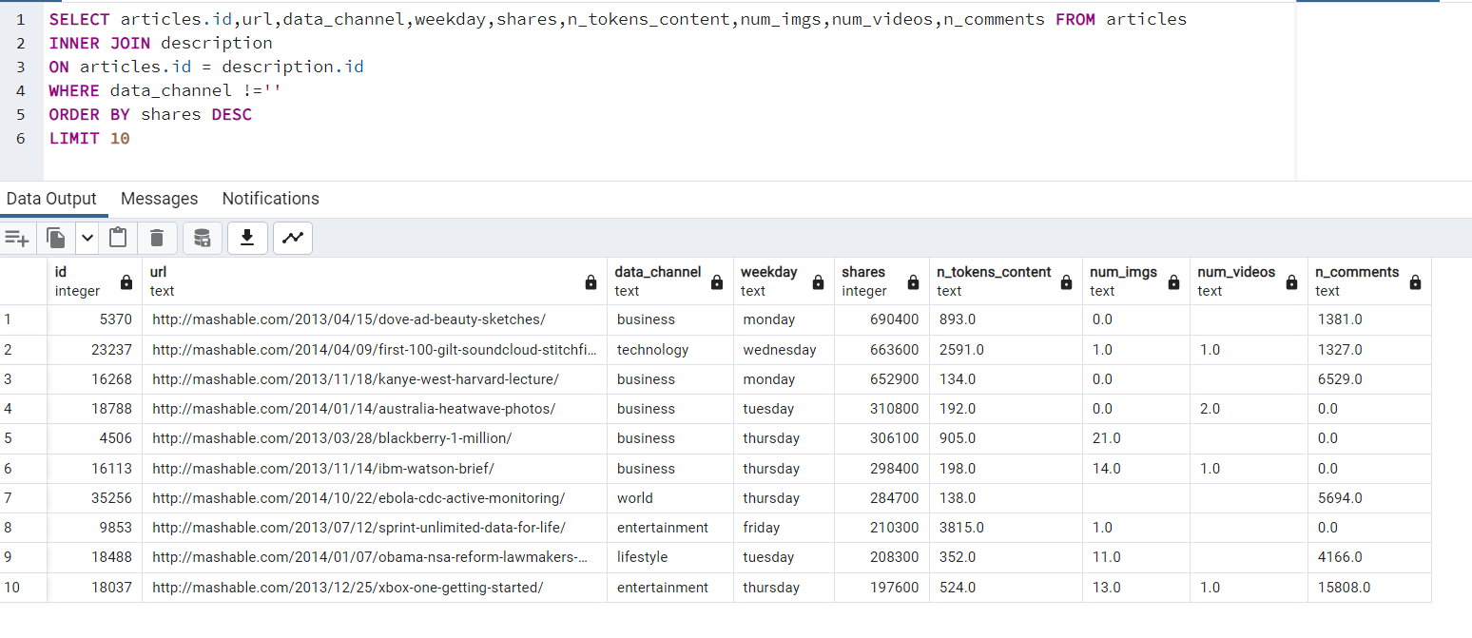
Article with the highest share

Slide 9
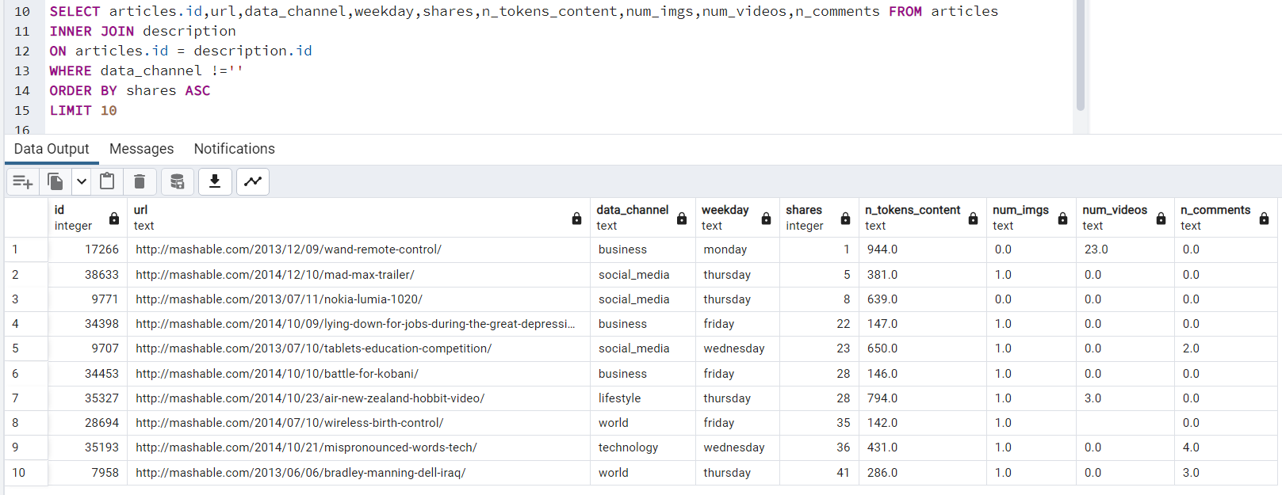
Article with the lowest share

Slide 10
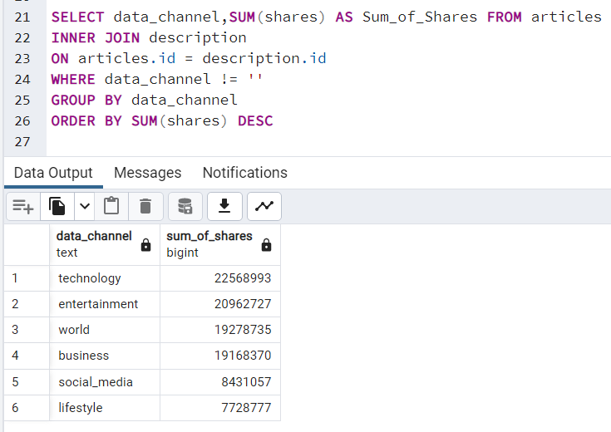
Data channel with the highest share

Slide 11
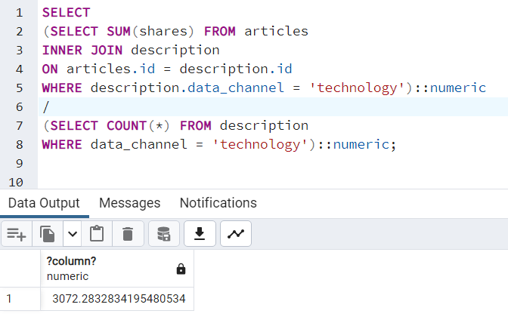
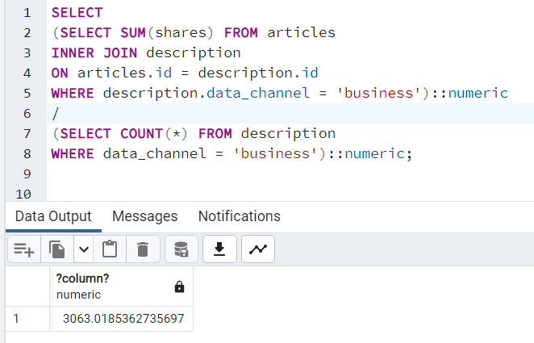
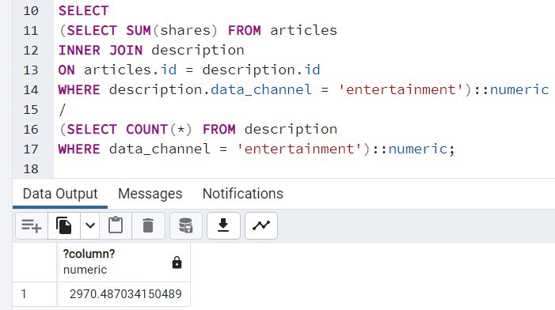
Average number of shares out of the number of articles for each data channel
Avg for Technology: 3072
Avg for Business: 3063
Avg for Entertainment: 2970

Slide 12
Sum of shares for each data channel

Slide 13
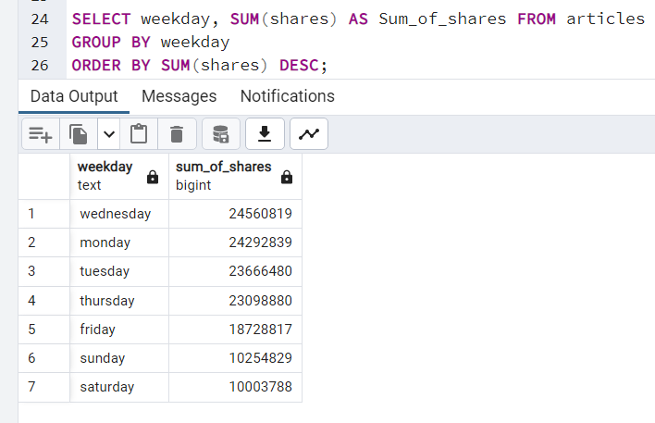
Sum of shares for each day of the week
Highest number of shares happen to be on Wednesday followed by Monday instead of a weekend

Slide 14
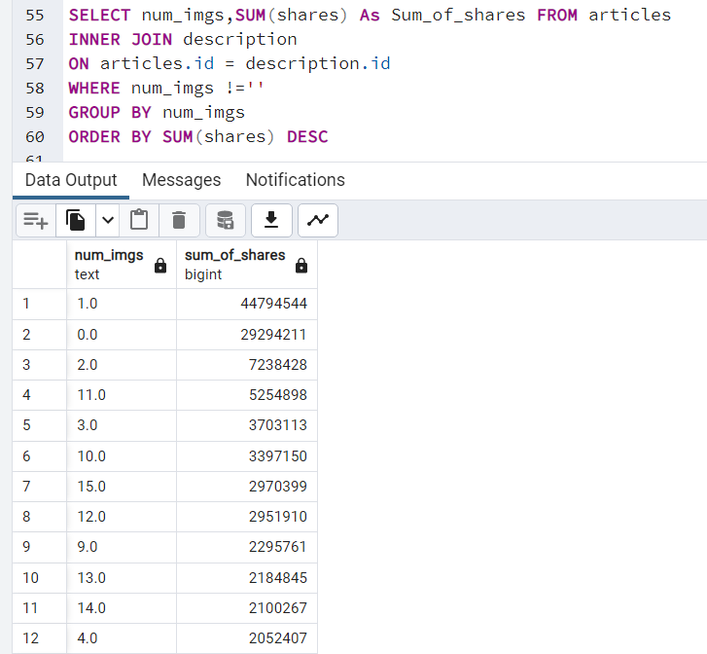
The number of images for the highest number of shares
The highest number shares has 1 image only

Slide 15
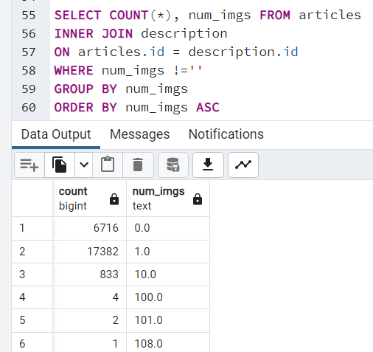
Average share per article with x number of images
The number of images does not affect the number of shares
Average share per article with 0 image = 4361.85
Average share per article with 1 image = 2577.00
Average share per article with 2 image = 2549.64

Slide 16
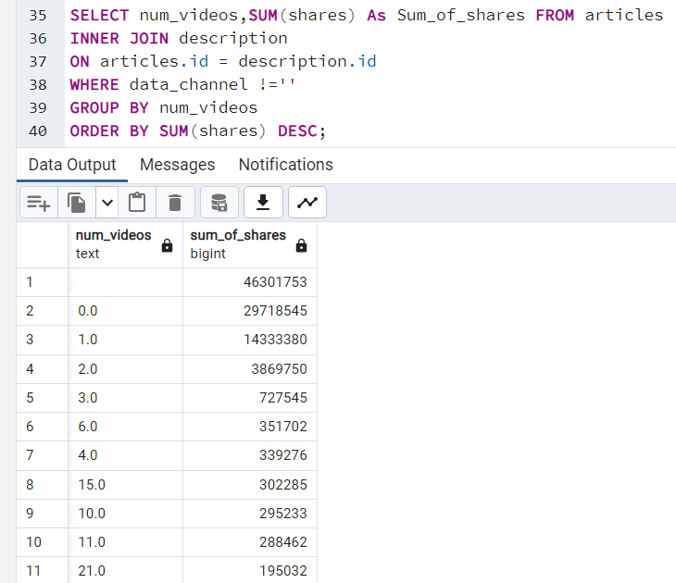
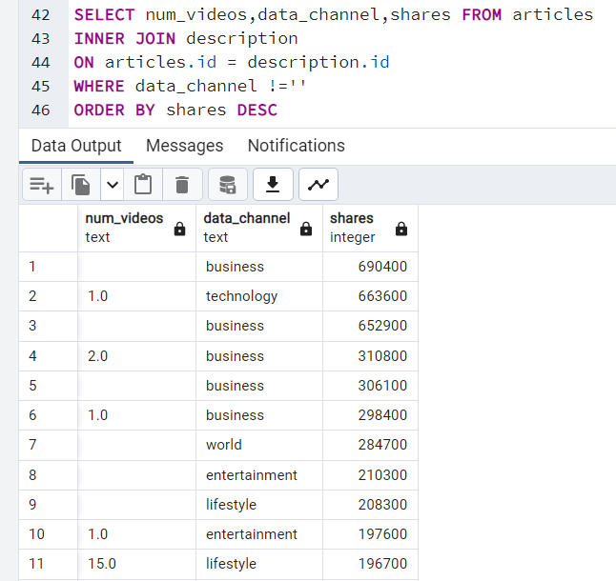
The number of videos for the highest number of shares (for different data channel)

Slide 17
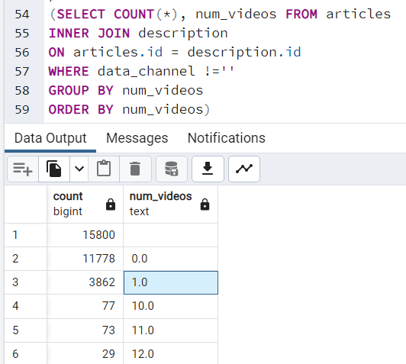
Average share per article with x number of videos The number of videos does affect the number of shares
Average share per article with 0 video = 2523.22
Average share per article with 1 video = 3711.38
Average share per article with 2 video = 3353.34

Slide 18
Insights
Top category of news is Technology
Most people visit the news website or access the articles on weekdays instead of weekends
Number of images does not affects the number of shares
Whereas the number of videos will affect the number of shares

